Slide 1
Dashboard Summary
Project Name: Coffee Sales Chain Analysis
Tool: Power BI
Dataset: Coffee Sales Chain Analysis
Objective: Analyze sales, profit, and product performance.
Coffee Sales Chain Analysis Dashboard was developed using Power BI to analyze sales performance, profitability, product trends, and market performance. The dashboard provides an interactive view of key business metrics through KPI cards, charts, and slicers, enabling stakeholders to monitor overall business performance effectively.
The dashboard includes key indicators such as Total Sales, Total Profit, Total Expenses, and Profit Margin. Interactive slicers allow users to filter data by Date, State, Market, and Product Line, making the analysis dynamic and user-friendly.

Slide 2
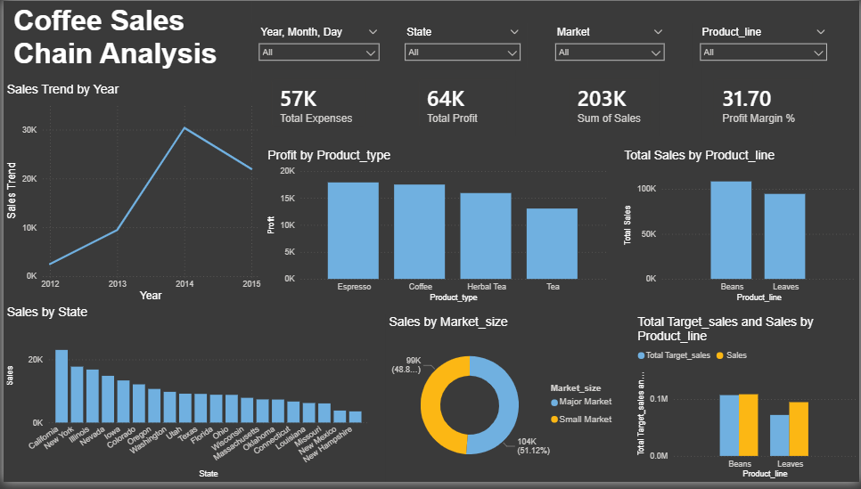
Key Insights
Total Sales: 203K
Total Profit: 64K
Profit Margin: 31.7%
California had the highest sales.
Espresso was the most profitable product type.
Actual sales met/exceeded targets for key product lines.

